Slide 1
PPO design choice for Intersection task
PPO is a stable on policy DRL algorithm widely used for autonomous driving tasks
Provides reliable convergence through clipped policy updates
Works with both:
  CNN policies (GrayscaleObservation)
  MLP policies (LidarObservation)
Balanced performance, stability, and implementation simplicity
Well supported in stable-baselines3 for reproducible training

Slide 2
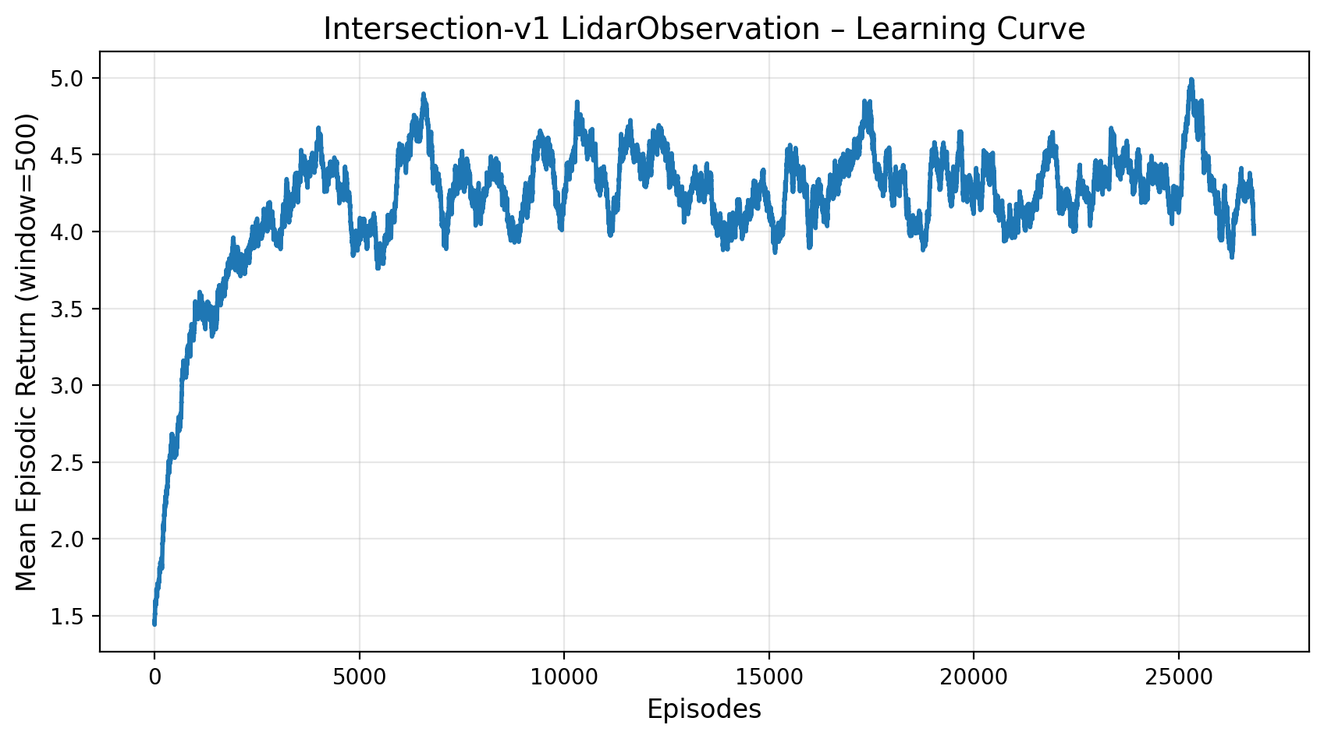
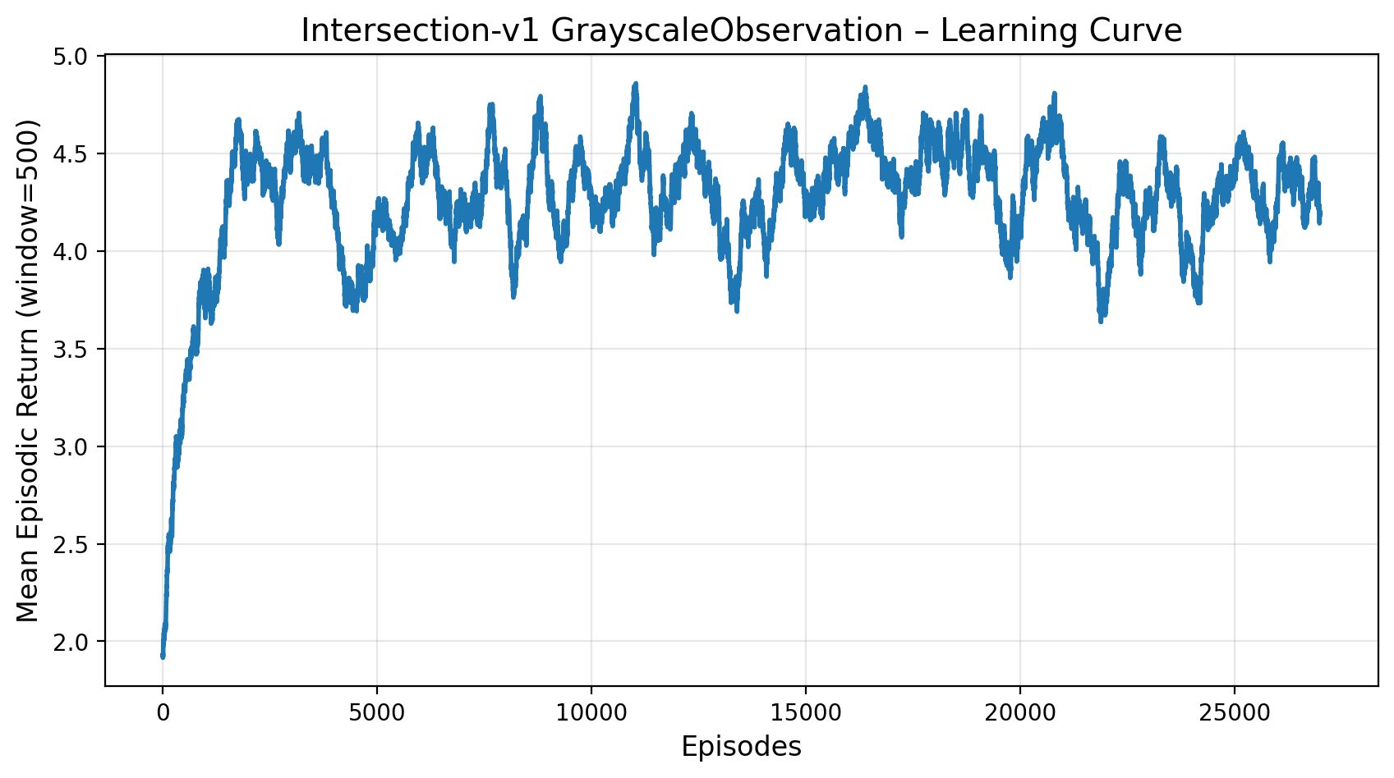
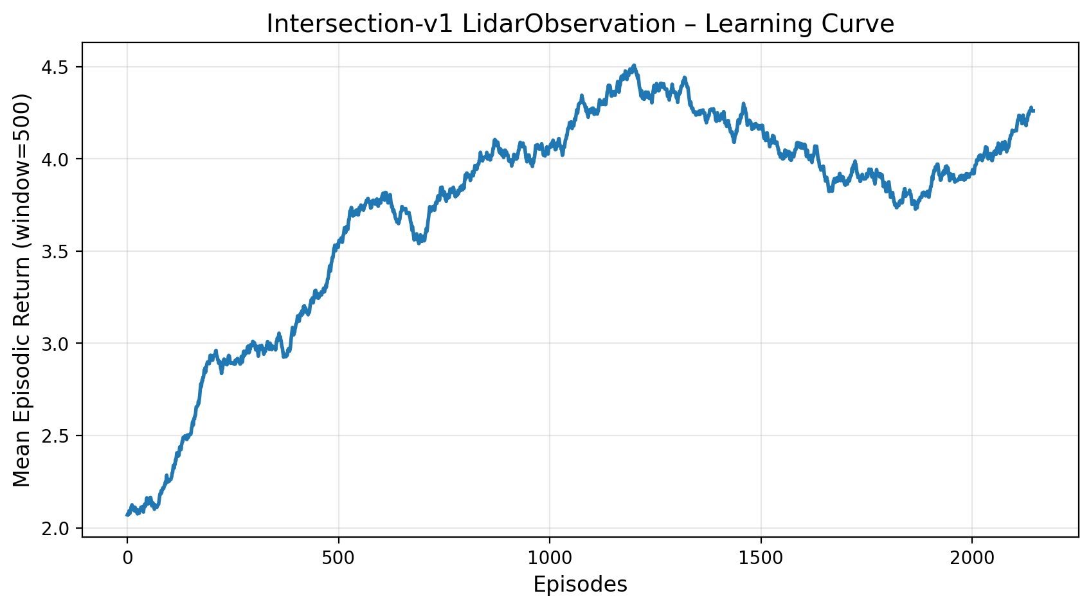
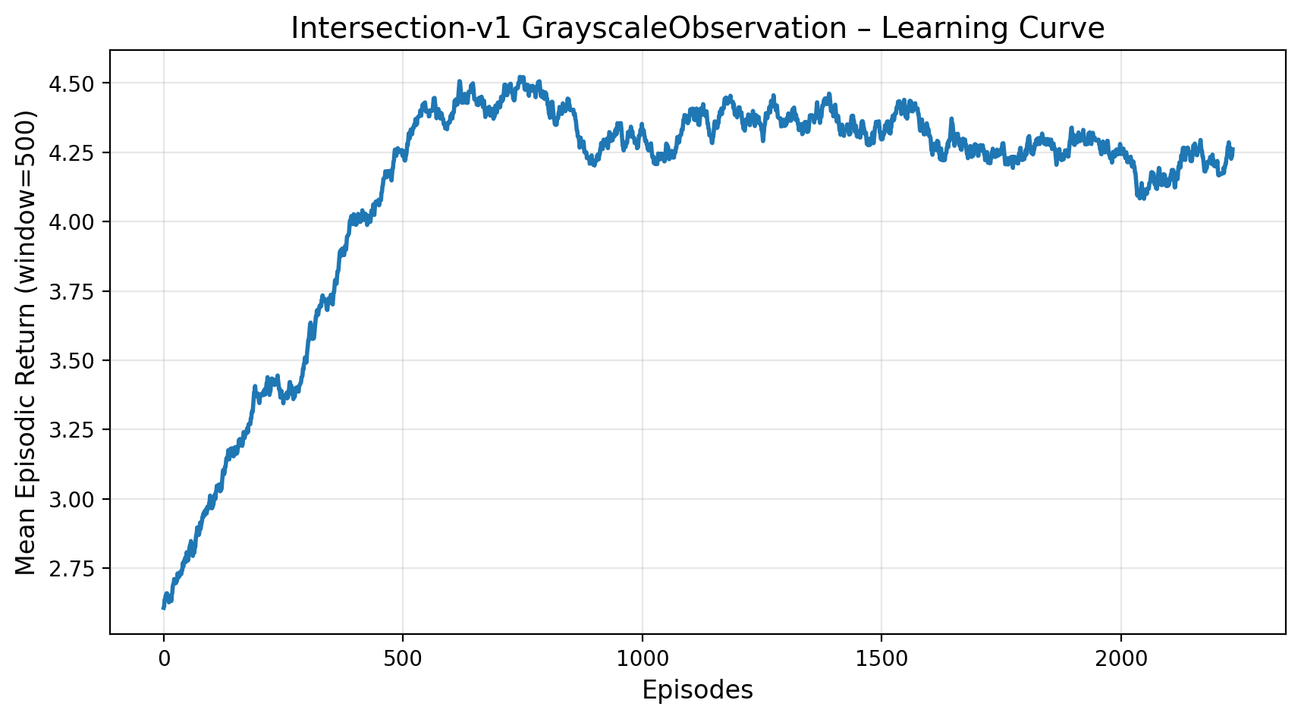
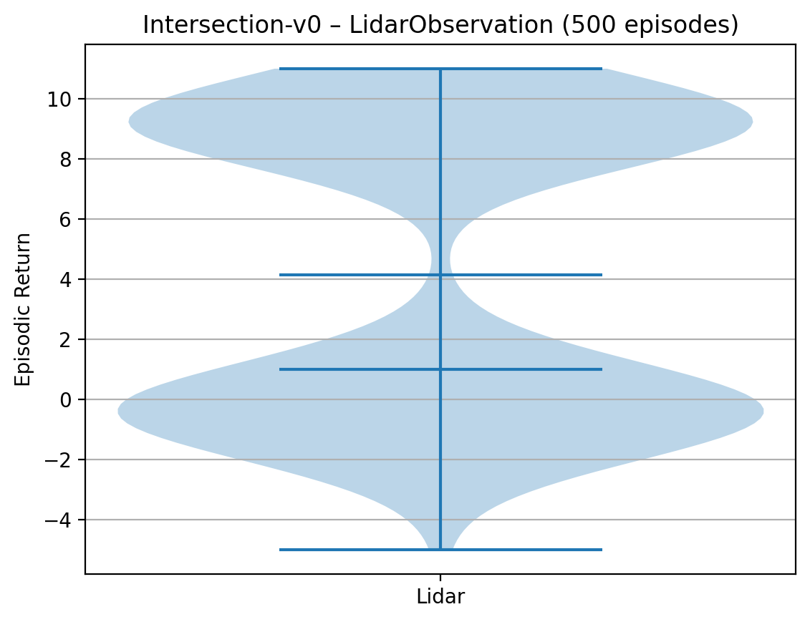
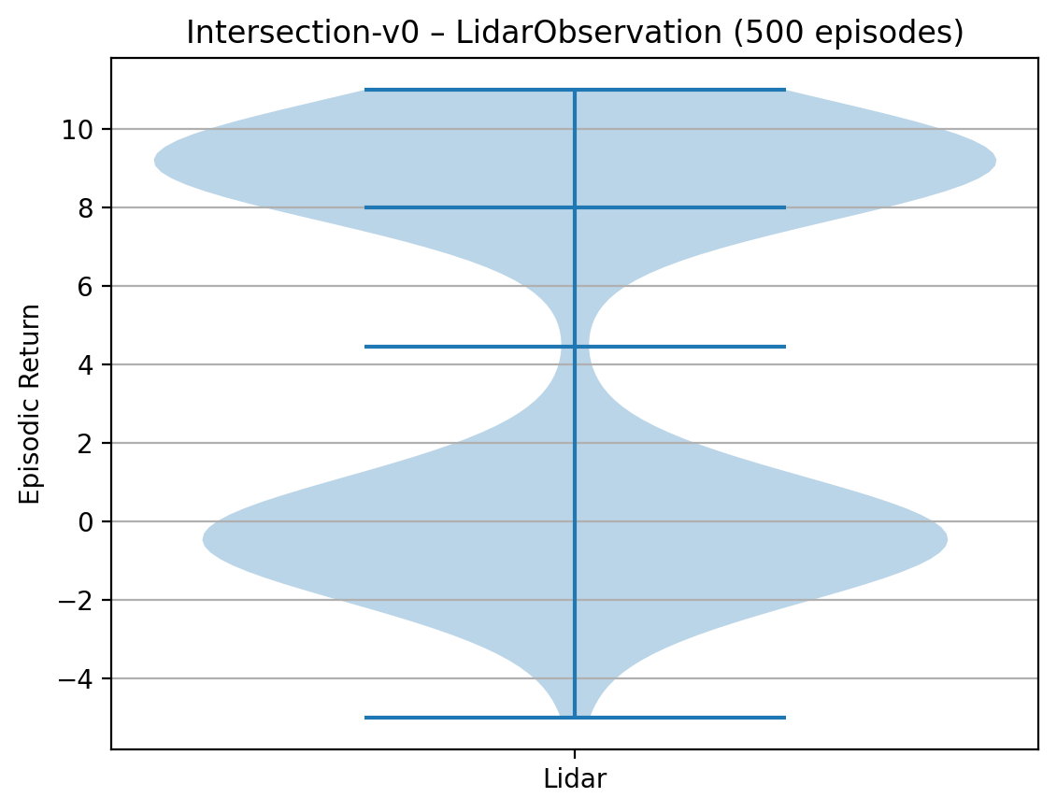
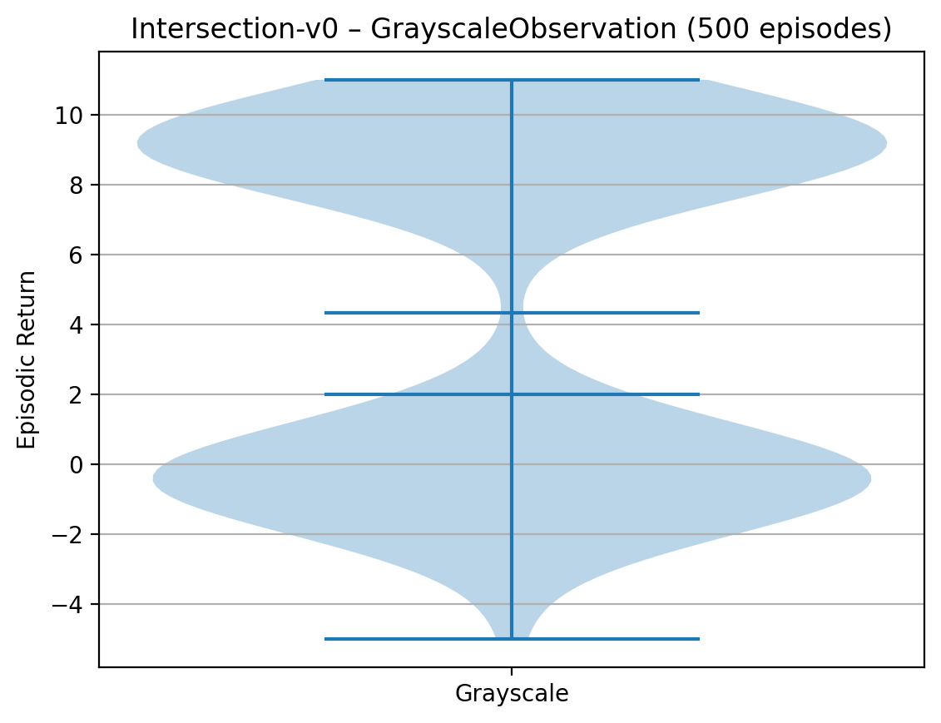
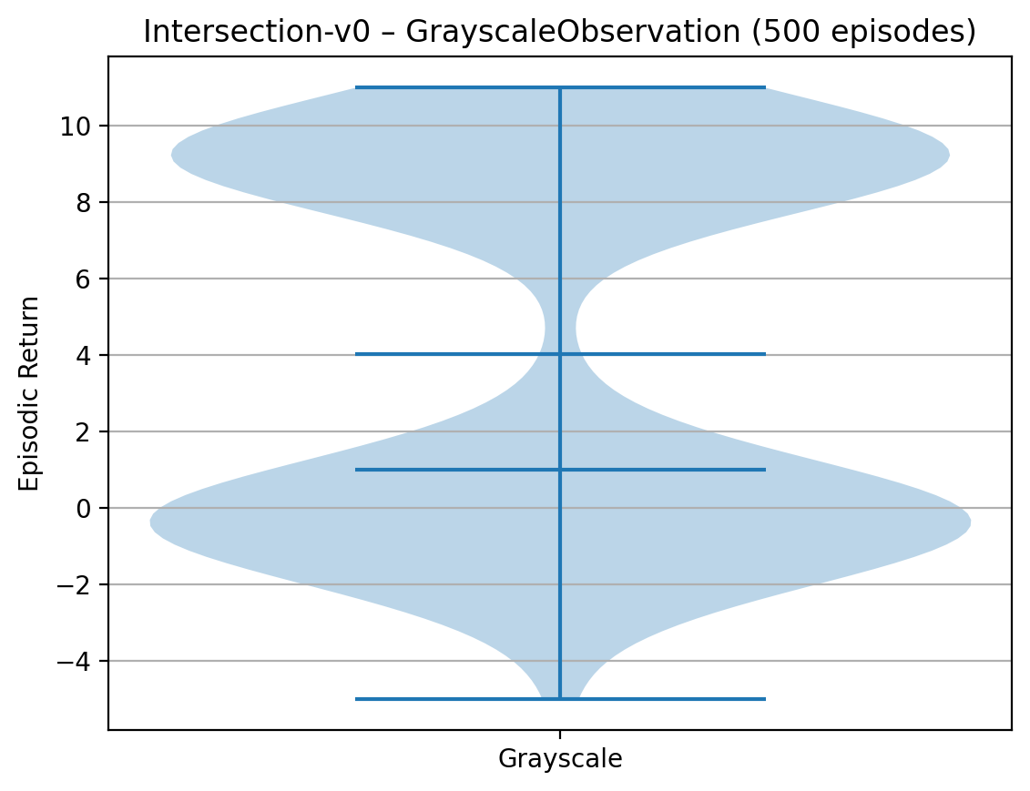
Intersection: Greyscale vs Lidar plots

Slide 3
Intersection: Greyscale vs Lidar conclusion
Both agents successfully learn the intersection navigation task, with smoothed returns converging in the 4.3 - 4.7 range
Grayscale (CNN policy):
  Learns faster in the early episodes, the visual input helps the agent quickly capture lane layout and other vehicles
  Achieves slightly higher peaks at several points (up to around 4.8-4.9)
  Final results fluctuates but stays roughly between 4.4 and 4.7
Lidar (MLP policy):
  Starts off a bit slower because the 1D Lidar representation is more abstract
  Gradually catches up and reaches similar long-term performance, with occasional peaks close to 5
  Fial smoothed return typically lies in the 4.2–4.6 range
Violin plots show that both agents have very similar episodic return distributions (roughly -5 to +11), with close medians and upper quartiles, indicating comparable overall performance
Trade off:
  Grayscale provides richer perception = faster initial learning
  Lidar is lightweight and efficient = similar long-term performance once training converges

Slide 4
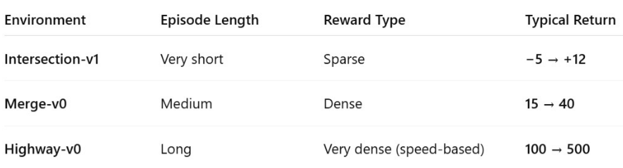
Environment reward scale comparison

